Slide 1
Regional Customer support – competence training information
Alpha Project
Lars Hagen – project leader
06.03.2023

Slide 2
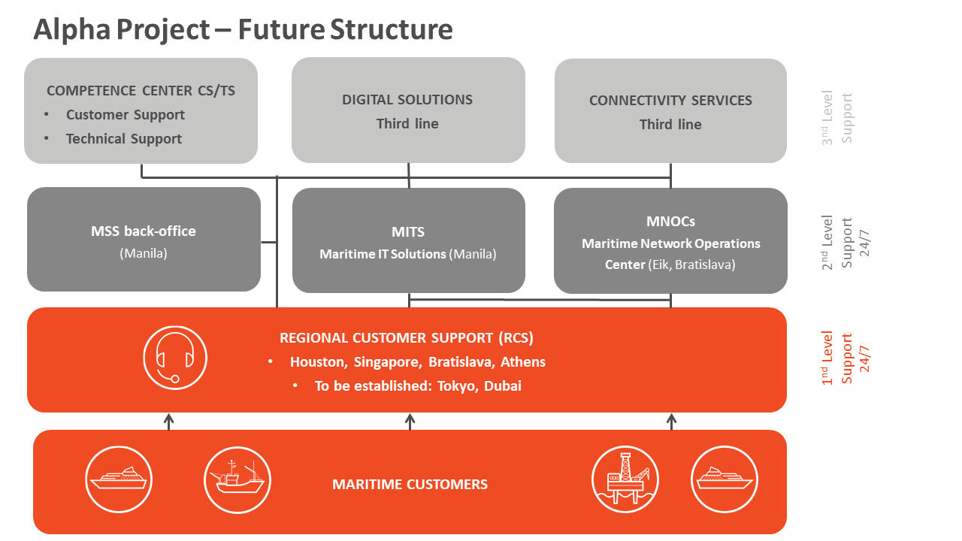
Alpha project information flow structure

Slide 3
Regional Customer Support – «Being the first responder»
Mission – realigning global Regional customer support organization. Increasing problem solving ability in the first point of contact (RCS) – retraining RCS with MNOC personnel (Eik/Ausseguel). Following the sun principle for 1st level (RCS) and 24/7 for 2nd level teams.
Each RCS location – one set of customers – no matter where their ships are in the world
Each location that receives an incident or request will be in charge of it until it is solved – no matter where it technically gets solved – the receiving RCS will be responsible for keeping the customer informed of progress (or no progress) until closing of ticket. Closing of can only happen from the originating RCS.
To achieved this the RCS will handle tickets that are advanced and simple, so it is important to like being the customers helpers, not only technical solutions operators.
There will still be possible to escalated to the central MNOC (24/7) – and regional MNOC in the Alpha project transition phase – year 2023.

Slide 4
Regional Customer Support – «Being the first responder»
We aim to merge the regional MNOC’s with the regional SD’s
We aim at a higher level of “first-time/first contact fix-rate”, less escalations
This will be a gradual process
KPI > 60% first-time fix in 2024
KPI > 70% first-time fix in 2025
To achieve this, we will embark on a training program to ensure a wider understanding of the Marlink portfolio, this will entail online courses
We will try to customize this to individual needs
As the competence-level varies the need for training will also vary

Slide 5
Regional Customer Support – «Being the first responder»
Different locations will have different needs – but the goal everywhere is to be customer focused, as our customers have widely asked us for this.
Some locations are starting from scratch and other are closer to being what we aim for
So, we hope you will be patient to some extent
We aim to finish this year – but getting operations to work more optimally may take longer
!! Some strategic high-end customers will still have a special hot-line straight into the central MNOC in the future!! – Depending they have purchased the highest level SLA

Slide 6
New Organization
Maritime Operations
Eirik Haugerud
Operational Services
Juraj Baros
Customized Projects
Tore Morten Ruud
Projects Standard Solutions
Marek Lipka
Field Service
Gisle Asbjørnsen
Logistics Order Office
Geir Sivertsen
Regional Customer Support
Lars H. Vestby
2nd level Support
Erik Holtrin
MNOC Bratislava
Mikael Horvath
MNOC Eik
(Erik Holtrin)
MITS
Christian Ortanez
Service Coordination
RCS Japan
Wilko Visser
RCS Singapore
Htunn Lynn
RCS Dubai
Moutaz Abdalla
RCS Athens
Antonios Tsotras
RCS Bratislava
Rastislav Bavloar
RCS Houston
Juan Velazgues
MSS Practice
Kelly Hahne
MSS Backoffice
Service Management
Erik Hovden
CCTS
Franck Arganese
CCCS
Lucas Grenon
Competence Centre
Luc Feron

Slide 7
Service-Desk + MNOC-R = RCS- Regional Customer Support
We will make a training program – on line – that will define several level of training courses that aim at bringing juniors and senior staff up to the indivual necessary level
The content of the different incidents and requests will contain a wide variety of products and services – that is why the training will include all the products and services Marlink has to offer
The smaller teams – will of course need to escalate more than the larger teams, and the different offices need to be team-players and help each other out, as they also do at present
This will be monitored by the Director Regional Customer support
In RCS teams consisting of former Service desk and MNOK-R staff there will of course be junior and senior personnel – tasks may be divided according to skill set and qualifications by the local RCS line manager
Over time the training and experience in handling incidents and requests will increase the teams collective experience base
Building the 24/7 operation in Bratislava/Eik will of course take time depending on the availability of personnel

Slide 8
Training – Aspects we will focus on
We will try to customize the training to individual needs. The focus will be 3 main areas:
Technical training to cover the Marlink portfolio (the main sections)
Customer communications – how to handle customers (stressed customers) in a multitask environment
Marlink Support procedures
Examples…
How to registrer tickets in own and other regions/ how to close a ticket
When and how to escalate
We have people that have just begun working in Marlink and we have senior personnel – so we need to have a wide variety of lesson/courses and also on-the-job training with mentors
Technical training will involve mainly former SD personell and newly hires
Customer communication and new procedure handling will involve almost all
Training will be spaced out over time to allow people time to participate in, and process changes
Training is one thing, utilizing the systems and being effective is something else – this takes time

Slide 9
Alpha project – Regional Customer Support
The Alpha project will aim at combining the best in our current support organization with our customers future wishes
Customers divided into the regions/locations closes to them
First responders know their customers better
Escalation procedures in places like to day
VIP customer still have direct access to MNOC central 24/7
The changes will take time – this year (2023)
Some location start fresh some are getting further sooner
The transition phase may feel not optimal for the support organization
Training will help, continuity will help, following procedures will help
More information will be sent out as we go along

